Slide 1



Python Lover
Let’s Start
Presentation

Slide 2






Python Lover
MAHMUDUL HAQUE SHAWON
@Mahmudulhaqueshawon
COMPUTER SCIENCE & TECHNOLOGY
@shawon30

Slide 3

Overview
Java Inheritance
Java Polymorphism
Super class
Sub Class
Type of Inheritance
Overridden
Run time Polymorphism
01
02
03
04
05
06
07

Slide 4


Inheritance
Java inheritance is a mechanism in object-oriented programming (OOP) that allows one class to inherit the properties (fields) and behaviors (methods) of another class. This promotes code reuse and establishes a relationship between the parent (superclass) and child (subclass) classes.
Code Reusability
Flexibility
Hierarchical Structure
Inheritance allows a subclass to inherit methods and fields from a superclass, which means you can reuse the code already defined in the parent class. This avoids duplication and promotes cleaner, more maintainable code
Inheritance makes it easy to extend existing code by adding new functionalities without modifying the existing codebase
Inheritance helps to model real-world relationships. By establishing parent-child relationships, inheritance provides a clear and logical structure

Slide 5
Parant
Single Inheritance
A class can inherit from only one superclass.
child

Slide 6
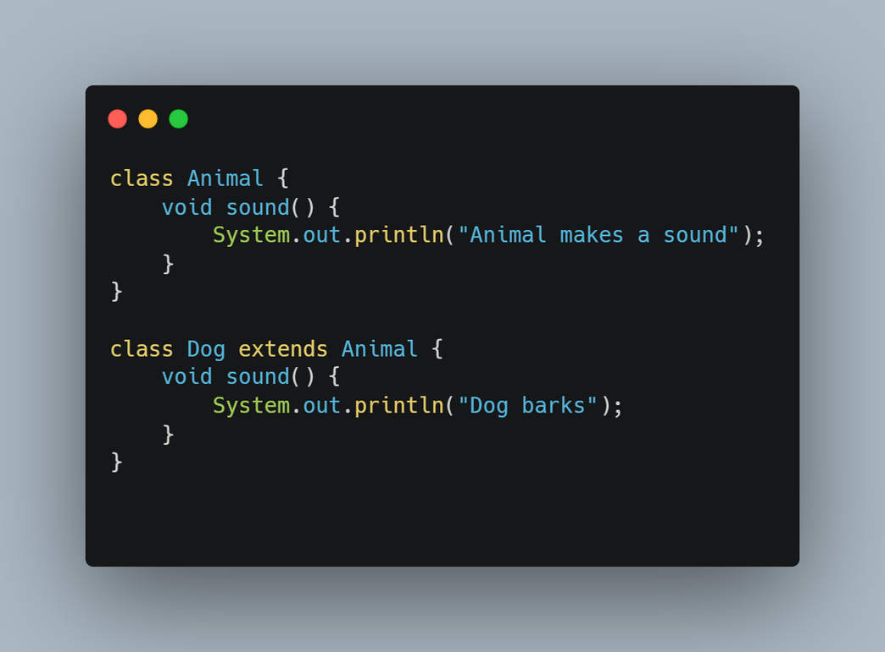
Single Inheritance
A class can inherit from only one superclass.

Slide 7
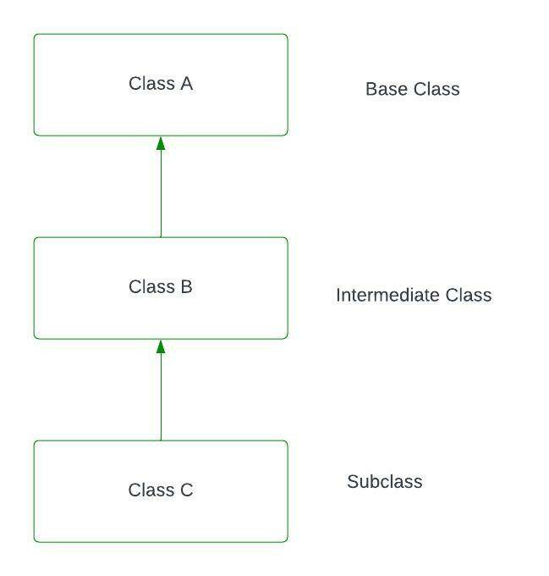
Multilevel Inheritance
A class can inherit from a class that is also a subclass of another class. Essentially, a chain of inheritance.

Slide 8
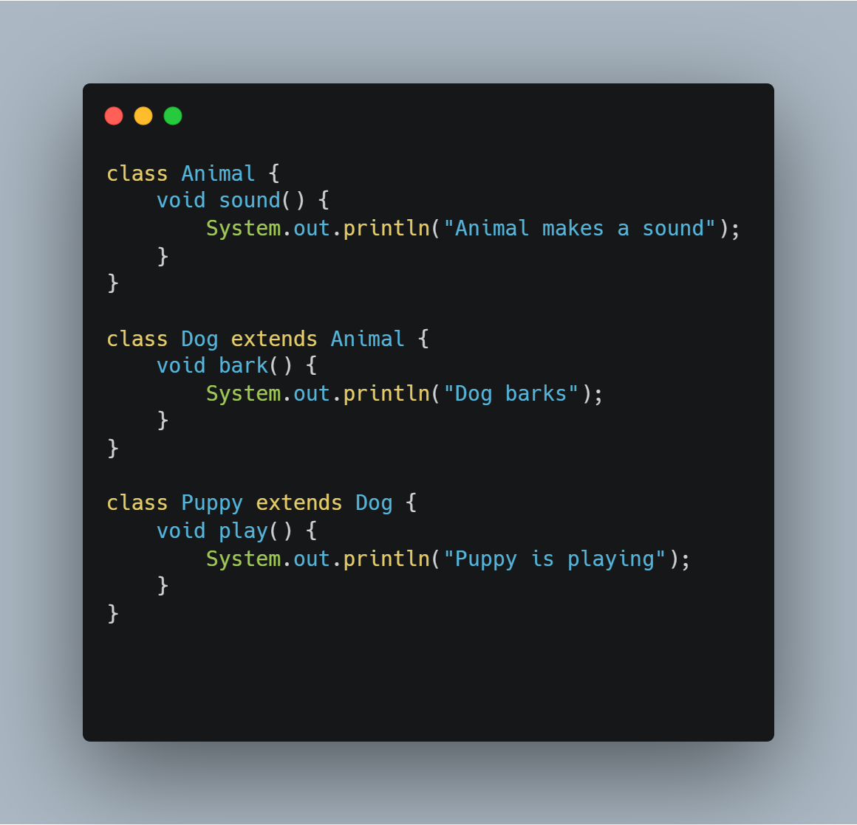
Multilevel Inheritance
A class can inherit from a class that is also a subclass of another class. Essentially, a chain of inheritance.

Slide 9
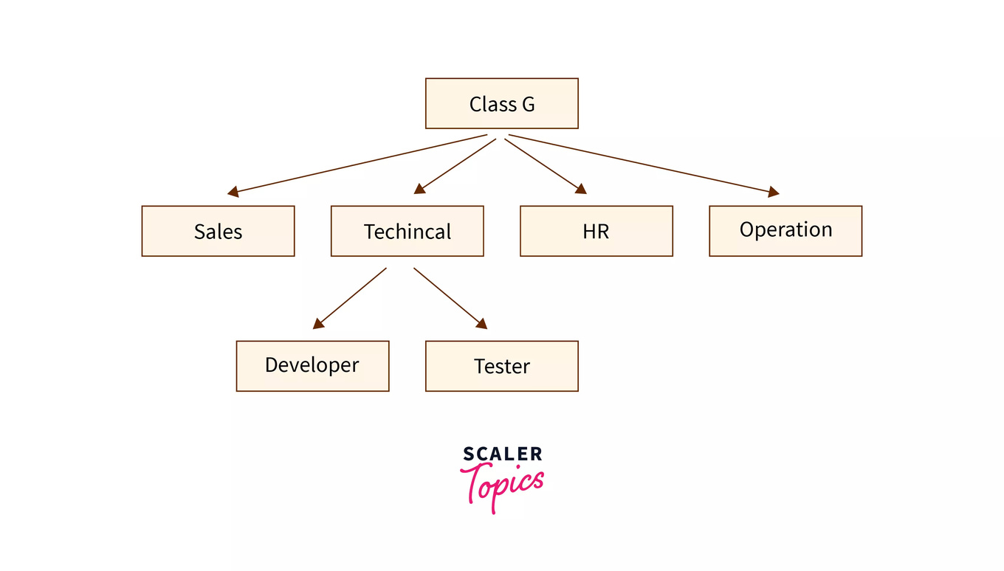
Hierarchical Inheritance
Hierarchical inheritance is a programming concept that allows multiple classes to inherit from a single superclass

Slide 10
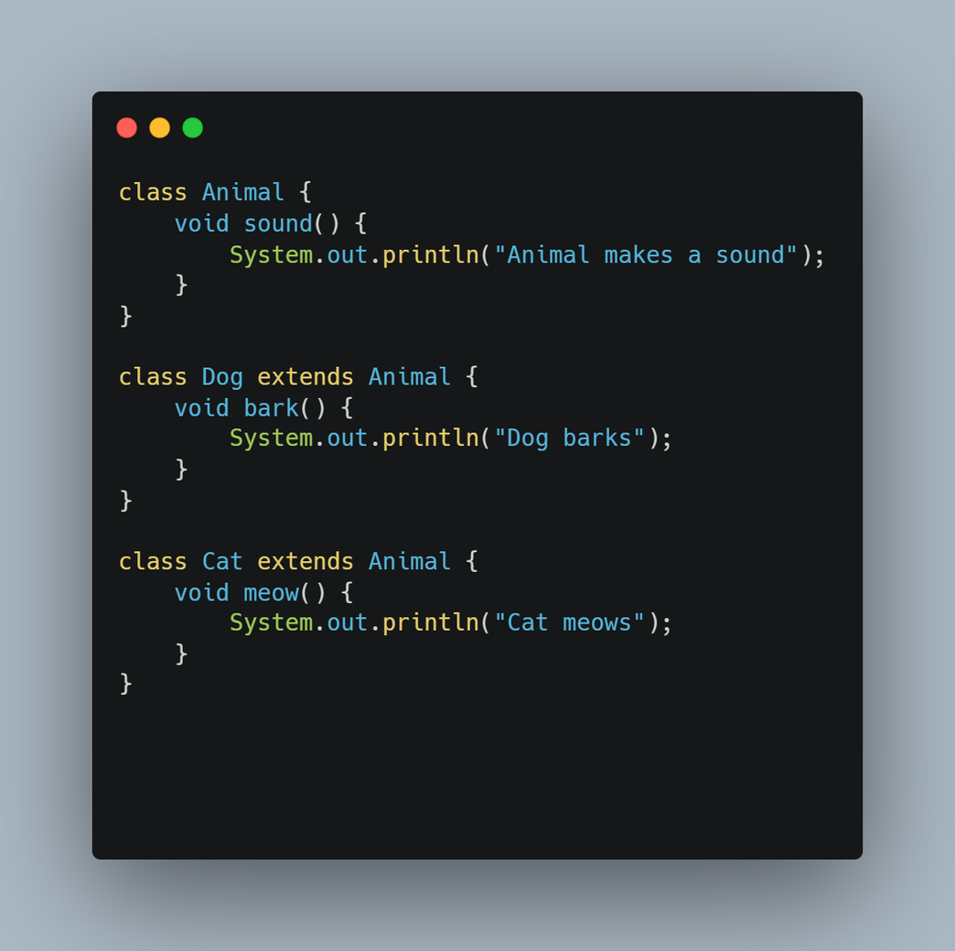
Hierarchical Inheritance
Hierarchical inheritance is a programming concept that allows multiple classes to inherit from a single superclass

Slide 11
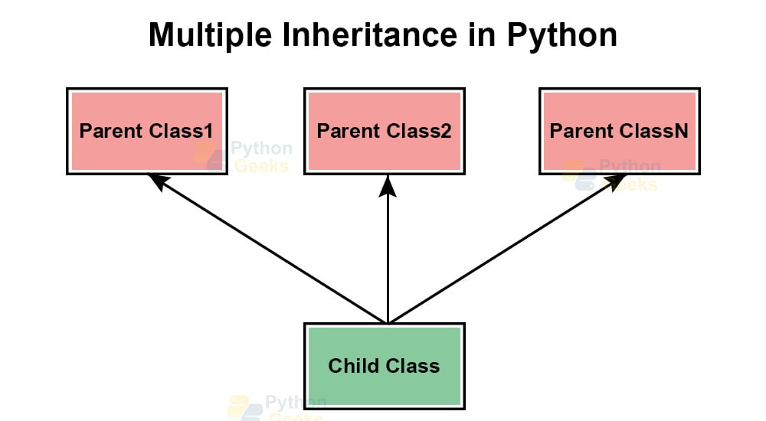
Multiple Inheritance
Multiple inheritance is a programming feature that allows a class or object to inherit characteristics from more than one parent class or object. It differs from single inheritance, where an object or class can only inherit from one parent class or object.

Slide 12
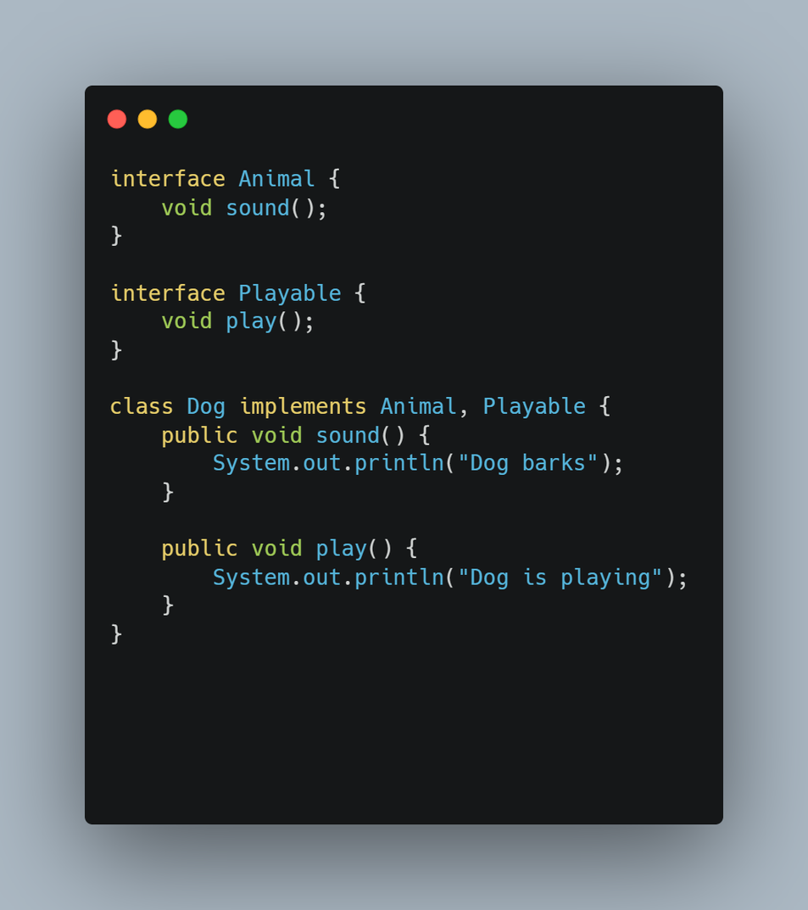
Multiple Inheritance
Multiple inheritance is a programming feature that allows a class or object to inherit characteristics from more than one parent class or object. It differs from single inheritance, where an object or class can only inherit from one parent class or object.

Slide 13
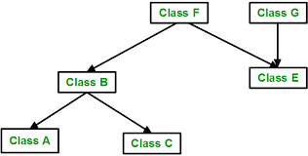
Hybrid Inheritance
Hybrid inheritance is a programming technique that combines multiple inheritance types to allow a class to inherit properties and behaviors from multiple sources. It's also known as multipath inheritance because it creates multiple paths through which a subclass can inherit properties.

Slide 14
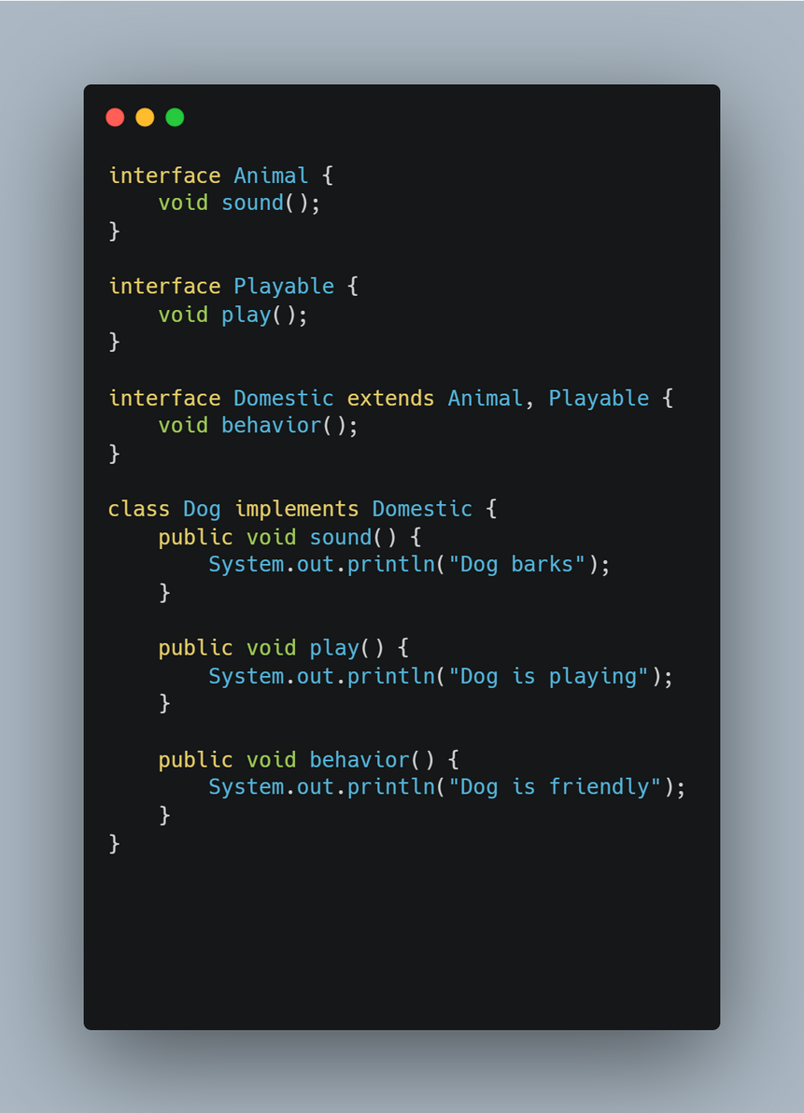
Hybrid Inheritance
Hybrid inheritance is a programming technique that combines multiple inheritance types to allow a class to inherit properties and behaviors from multiple sources. It's also known as multipath inheritance because it creates multiple paths through which a subclass can inherit properties.

Slide 15
In Java, polymorphism is the ability of an object to take on many forms. It allows methods to behave differently based on the object that invokes them. There are two types of polymorphism in Java
POLYMORPHISM

Slide 16
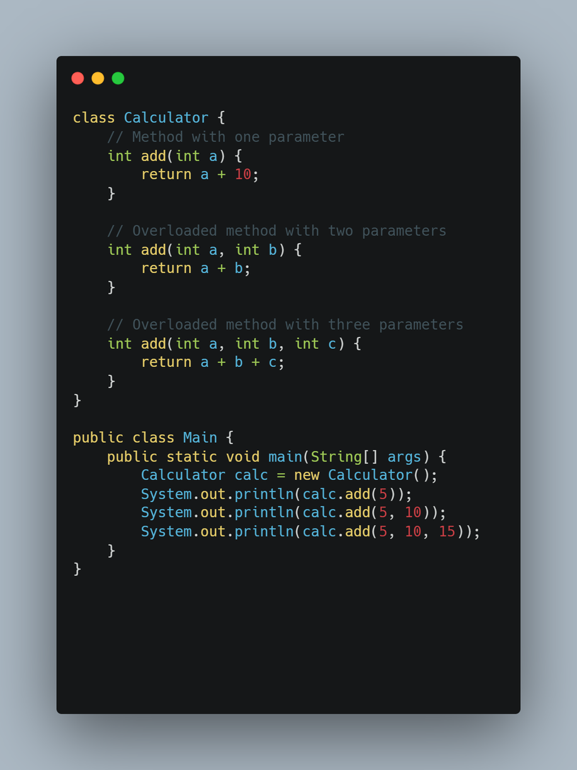
Method Overloading
This type of polymorphism is resolved during compile time. It occurs when multiple methods have the same name but differ in parameters (either by type, number, or both).

Slide 17
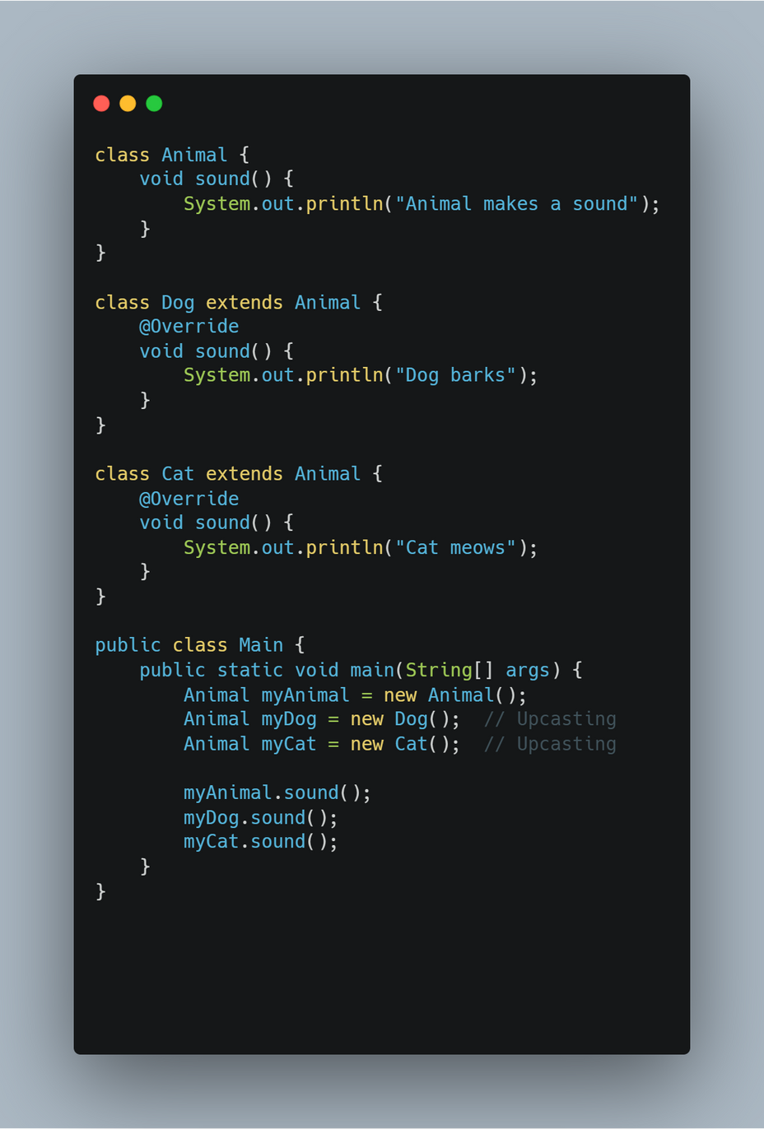
Runtime Polymorphism
This type of polymorphism is resolved during runtime. It occurs when a subclass provides its own implementation of a method that is already defined in its superclass. The method in the subclass overrides the method in the superclass

Slide 18





Thank You!
Contact Us
Phone
01323915030
Mail
haquemahmudul600@gmail.com
Website
shawon30.pythonanywhere.com
Address
Khoksa,Kushtia

